Slide 1
LIBRARY MANAGEMENT SYSTEM
Subtitle

Slide 2
GROUP MEMBERS
M.ASIM (21B-034-SE)
Hafiz M.Osaid Ahmed (21B-213-SE)
Huzaifa Khalid (21B-018-SE)
Sheroz Akhter (20B-078-SE)

Slide 3
INTRODUCTION
Efficiency: Automates library tasks, reducing manual work and improving accuracy.
Resource Management: Efficiently manages books, members, and transactions.
Problem Solver: Addresses challenges like manual record-keeping and data inconsistencies.

Slide 4
SIGNIFICANCE
Key Features:
Manage books, members, and transactions efficiently.
Reduce manual record-keeping.
Ensure data consistency.
Improve resource management.
Benefits:
Saves time and effort.
Minimizes errors.
Enhances library service quality.
Makes library management easier and more accurate.

Slide 5
OBJECTIVE & SCOPE
Objectives:
User-Friendly Interface: Create an easy-to-use interface for managing library resources.
Secure Access: Ensure safe access to the system with role-based authentication.
Reliable Data: Maintain accurate and consistent records for efficient library management.
Scope:
Management Modules: Includes book, member, and transaction management features.
User Experience: Focuses on a seamless experience for library staff and members.
Data Security: Ensures secure storage and handling of sensitive information.

Slide 6
Problem Statement
Manual Record-Keeping: Libraries face challenges with manual processes for record-keeping.
Data Inaccuracies: Manual methods can lead to inaccuracies in records.
Loss of Records: Risk of losing records due to manual handling.
Inefficiencies: Manual processes can be inefficient in managing library resources.
Need for Automation: Highlighting the need for automation in library management.

Slide 7
Solution
Efficient Management: Provides a system for efficient management of library resources.
Automated Tasks: Automates tasks to reduce errors and improve efficiency.
User-Friendly: Offers a simple and intuitive interface for ease of use.
Improved Data Accuracy: Enhances data accuracy by eliminating manual processes.

Slide 8
Key Features
Main Features:
Book Management: Comprehensive management of book records.
Member Management: Efficient handling of member information.
Transaction Management: Automated book loans and returns processing.
User-Friendly Interface: Intuitive GUI for easy navigation and data entry.
Unique Elements:
Real-time data updates and display.
Detailed transaction history and reporting features.
Integrated management panels for books, members, and transactions

Slide 9
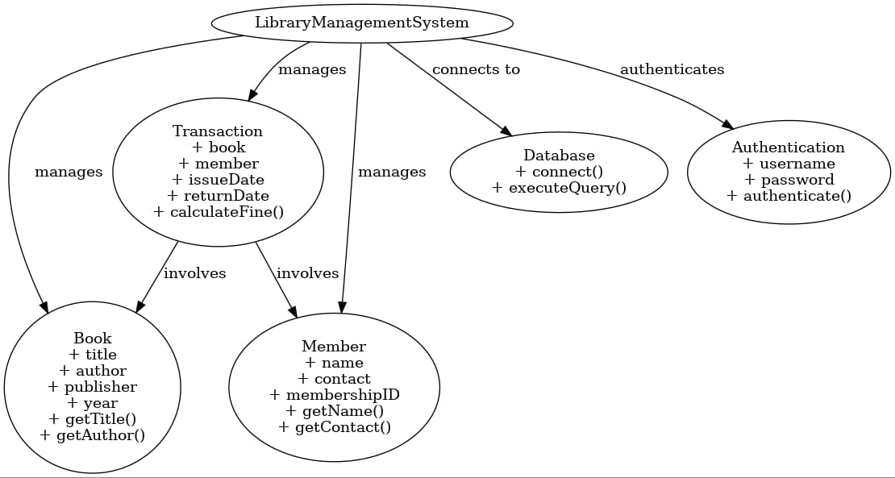
Architecture and Technologies

Slide 10
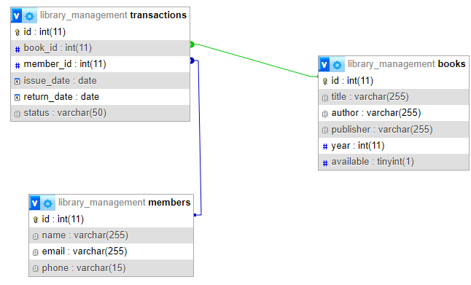
DATABASE Digram

Slide 11
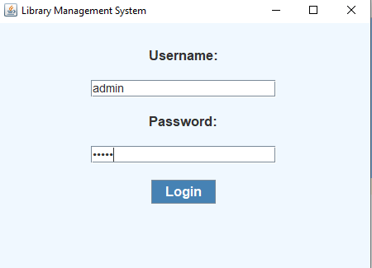
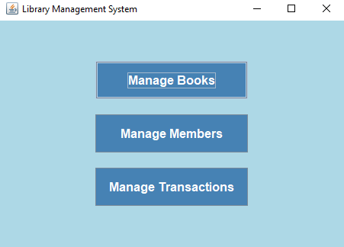
DEMO
Login Page Dashboard

Slide 12
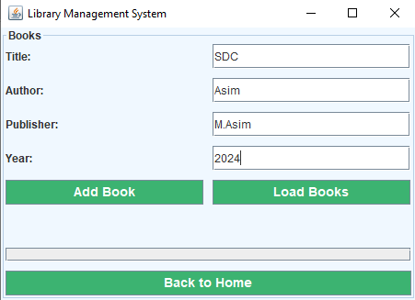
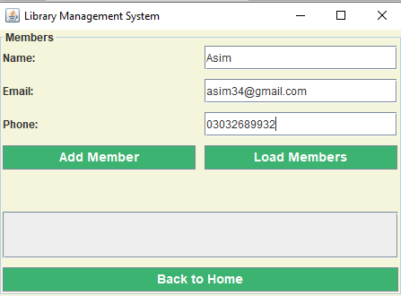
DEMO(cont.)
Add A Book Add A Member

Slide 13
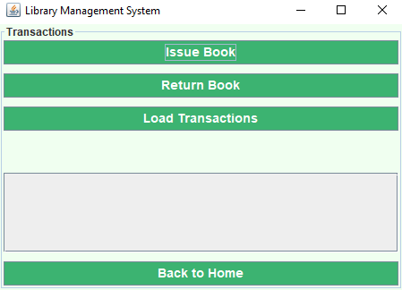
DEMO(cont.)
Transactions

Slide 14
Results and Achievements
Outcomes:
Successfully automated library operations, reducing manual errors.
Enhanced user experience for library staff and members.
Improved data accuracy and integrity.

Slide 15
Challenges
Ensuring real-time data updates and synchronization.
Designing an intuitive yet comprehensive user interface.
Implementing a secure and efficient authentication mechanism.

Slide 16
Overcoming Challenges:
Utilized efficient coding practices and design patterns.
Conducted extensive testing and user feedback sessions.
Implemented robust security measures and data handling procedures.

Slide 17
Future Enhancements
Potential Enhancements
Student Access: Enable students to reserve books and borrow e-books online.
Web & Mobile Versions: Create accessible web and mobile platforms.
Enhanced Reporting: Add advanced analytics and reporting tools.
Online Resources: Integrate access to digital content and databases.

Slide 18
Conclusion
Improved Efficiency: Automates and streamlines library operations.
Enhanced User Experience: Provides a user-friendly interface for staff and members.
Accurate Data Management: Ensures reliable and consistent record-keeping.
Future Expansion: Offers potential for growth with online access and advanced features.

Slide 19
THANK YOU

